Slide 1
Loan 360

Slide 2
Loan360 - Standard Operating Procedure
Table of Contents : -
Login Process
Dashboard Overview
Customer Search & Onboarding
KYC Search
Profile Document Verification
Profile Address & Profile Financial
Loan Application Creation Process
Fill Your Collateral Details
Fill Your Application -Scheme

Slide 3
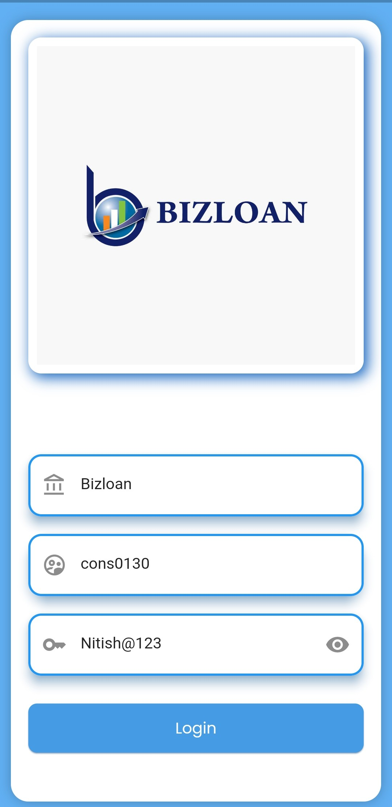
Procedure
Login Credentials
Company Code: Bizloan
Username: Emp code in small like e.g. : -bl000423
Password: Send to you when created

Slide 4
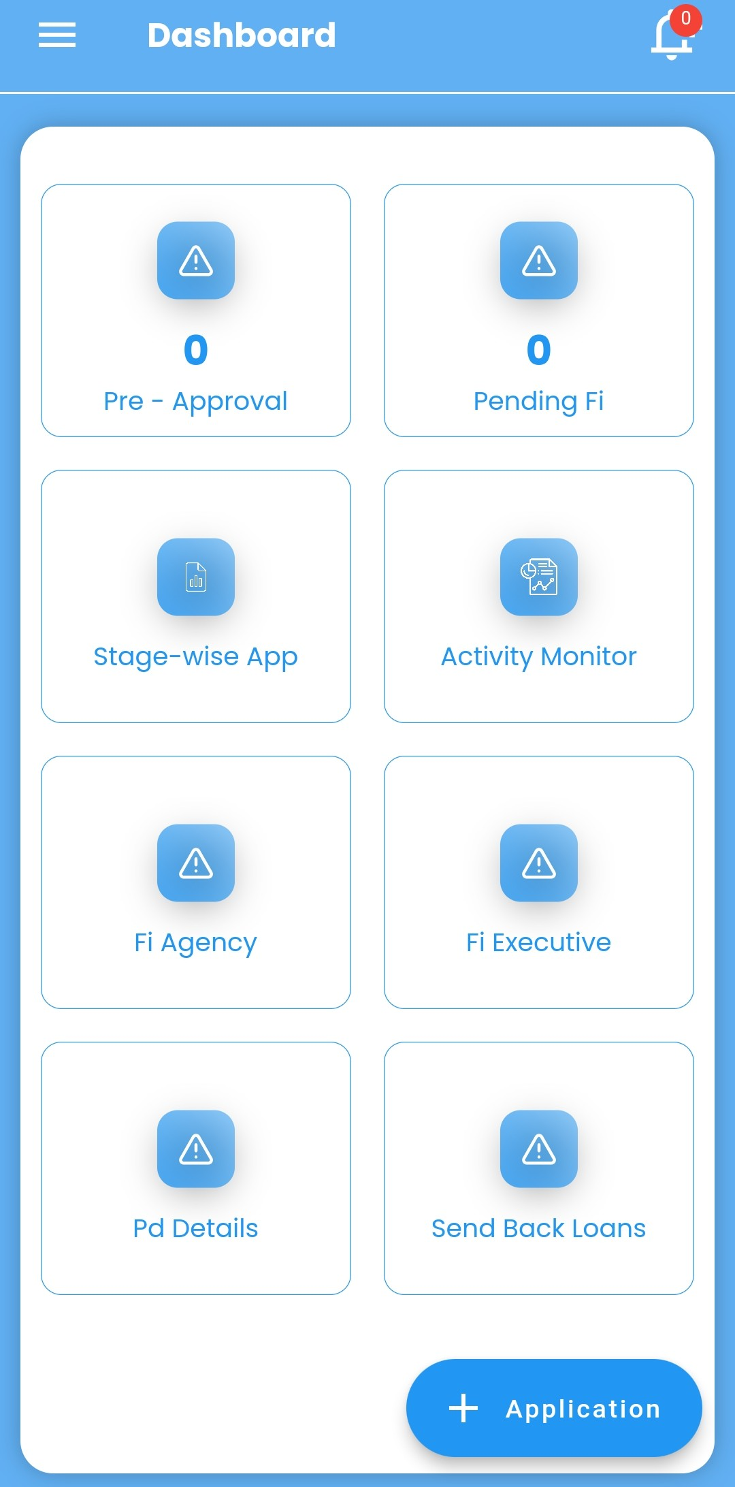
Dashboard Overview
Access the Dashboard to monitor and manage all stages of the loan application process.
Key Sections:
  Pre-Approval
  Stage-wise Application
  FI Agency & Executive
  PD Details
  Send Back Loans
  New Application Initiation

Slide 5
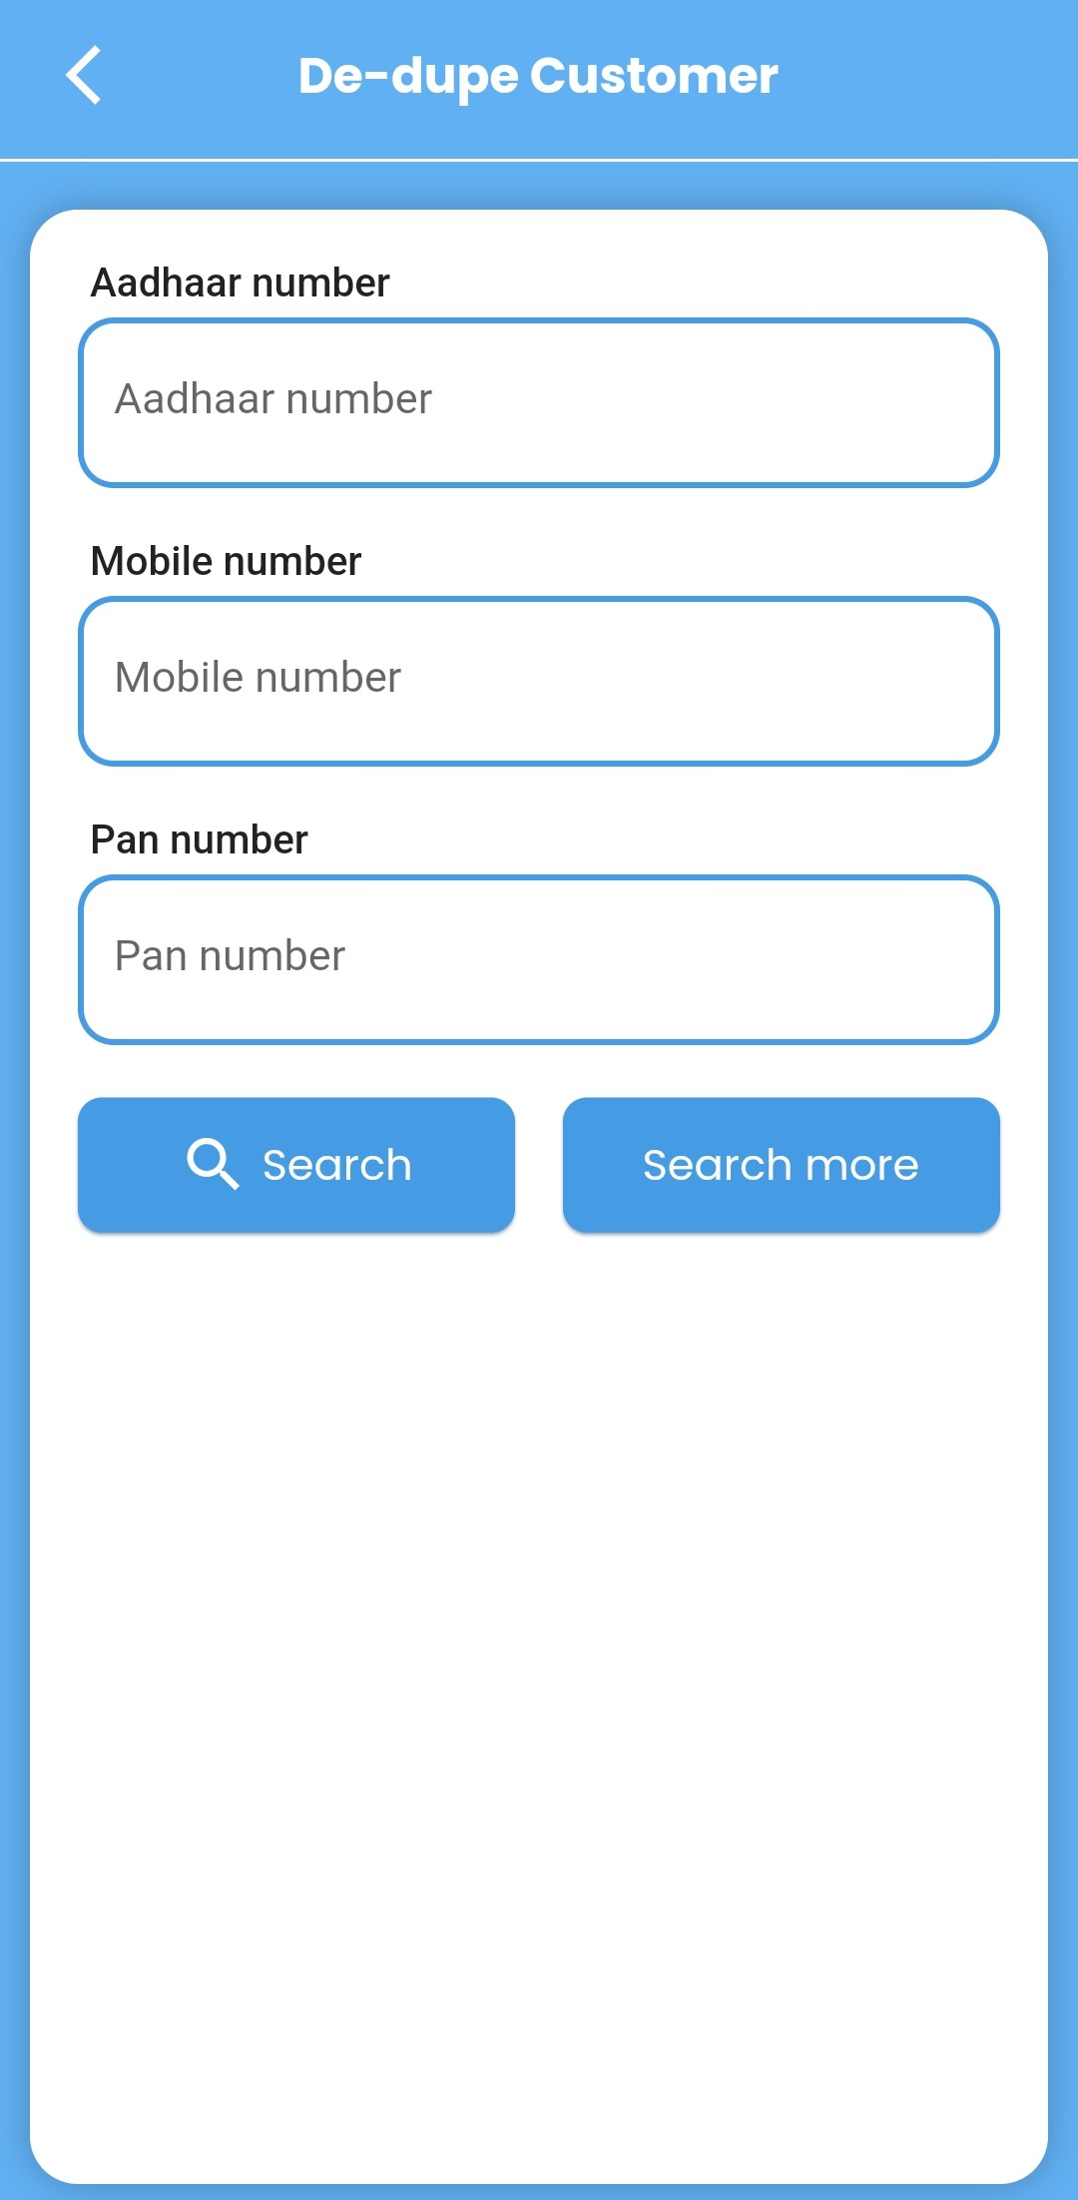
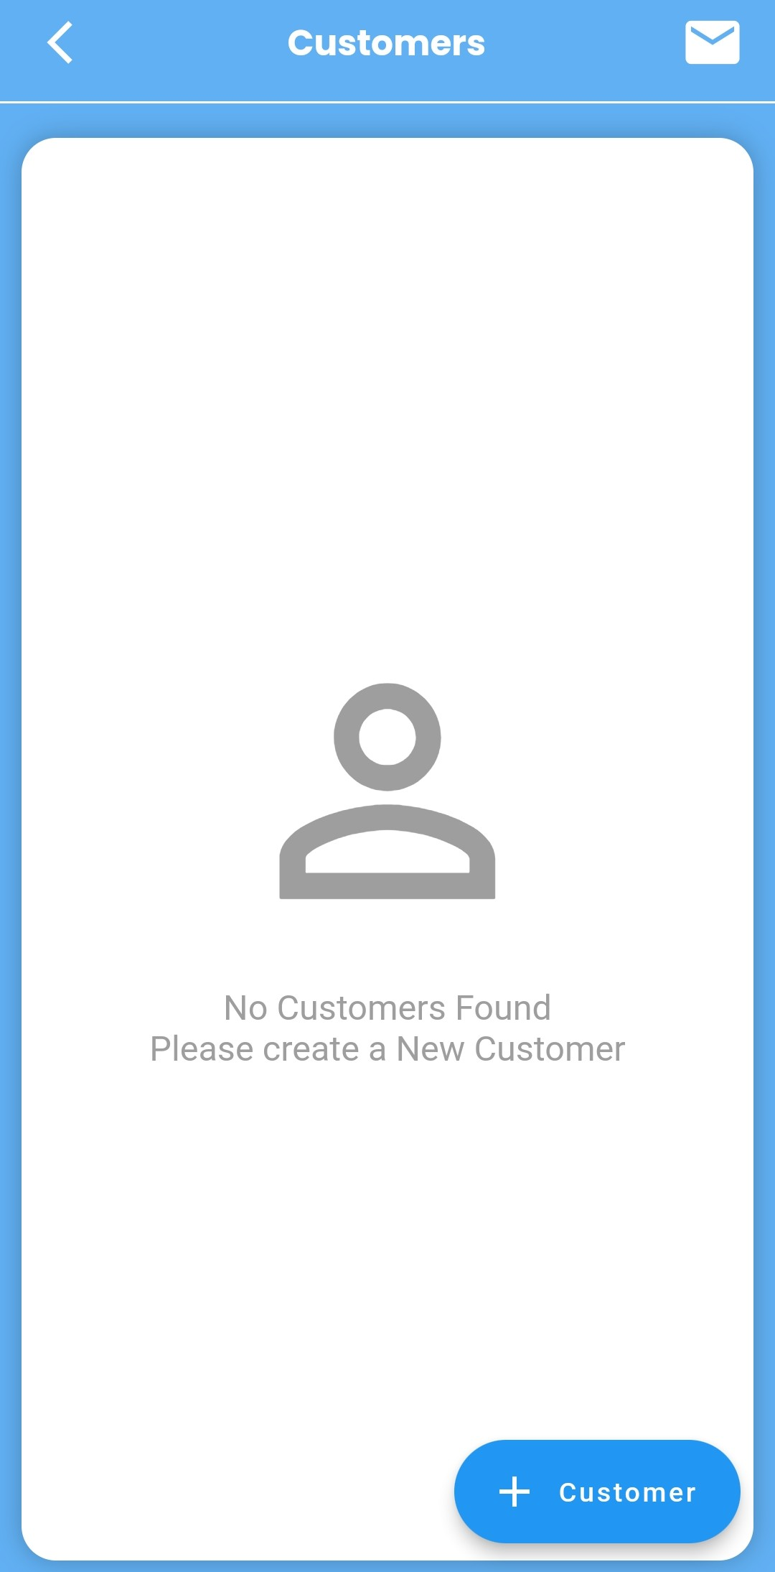
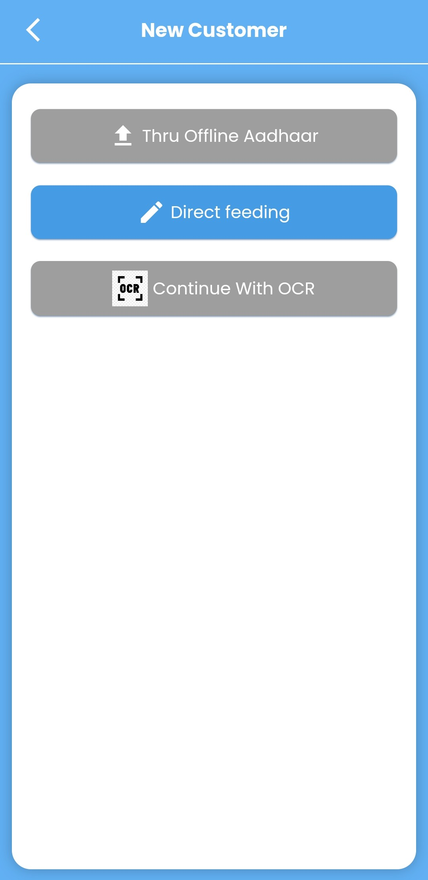
Customer Search & Onboarding
Navigate to the Customers section.
Search Customer If already in database.
If No Customers Found
Proceed to Create a New Customer using the "New Customer" function.
Customer Data Collection Methods
Customer data can be added through:
  Direct Feeding (Working Only)

Slide 6
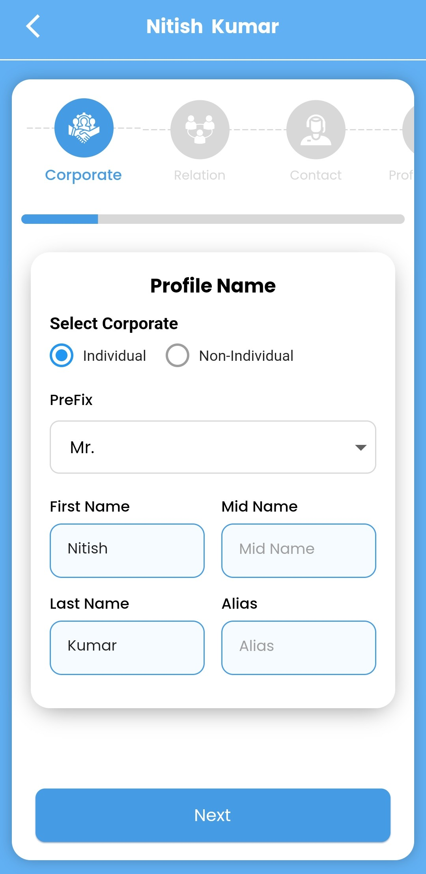
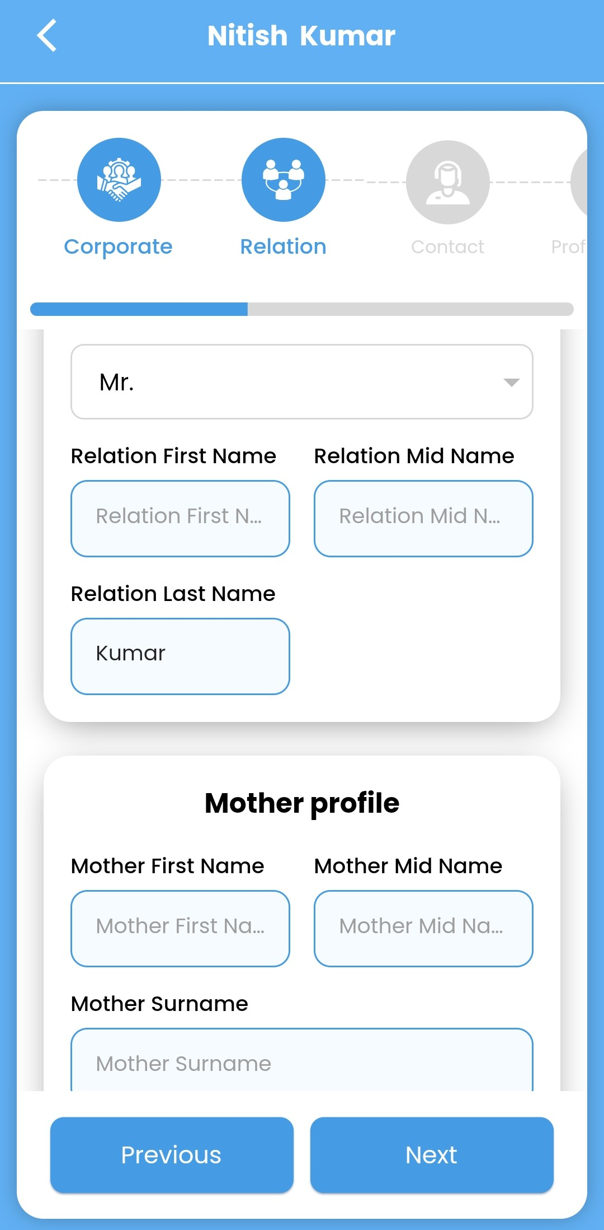
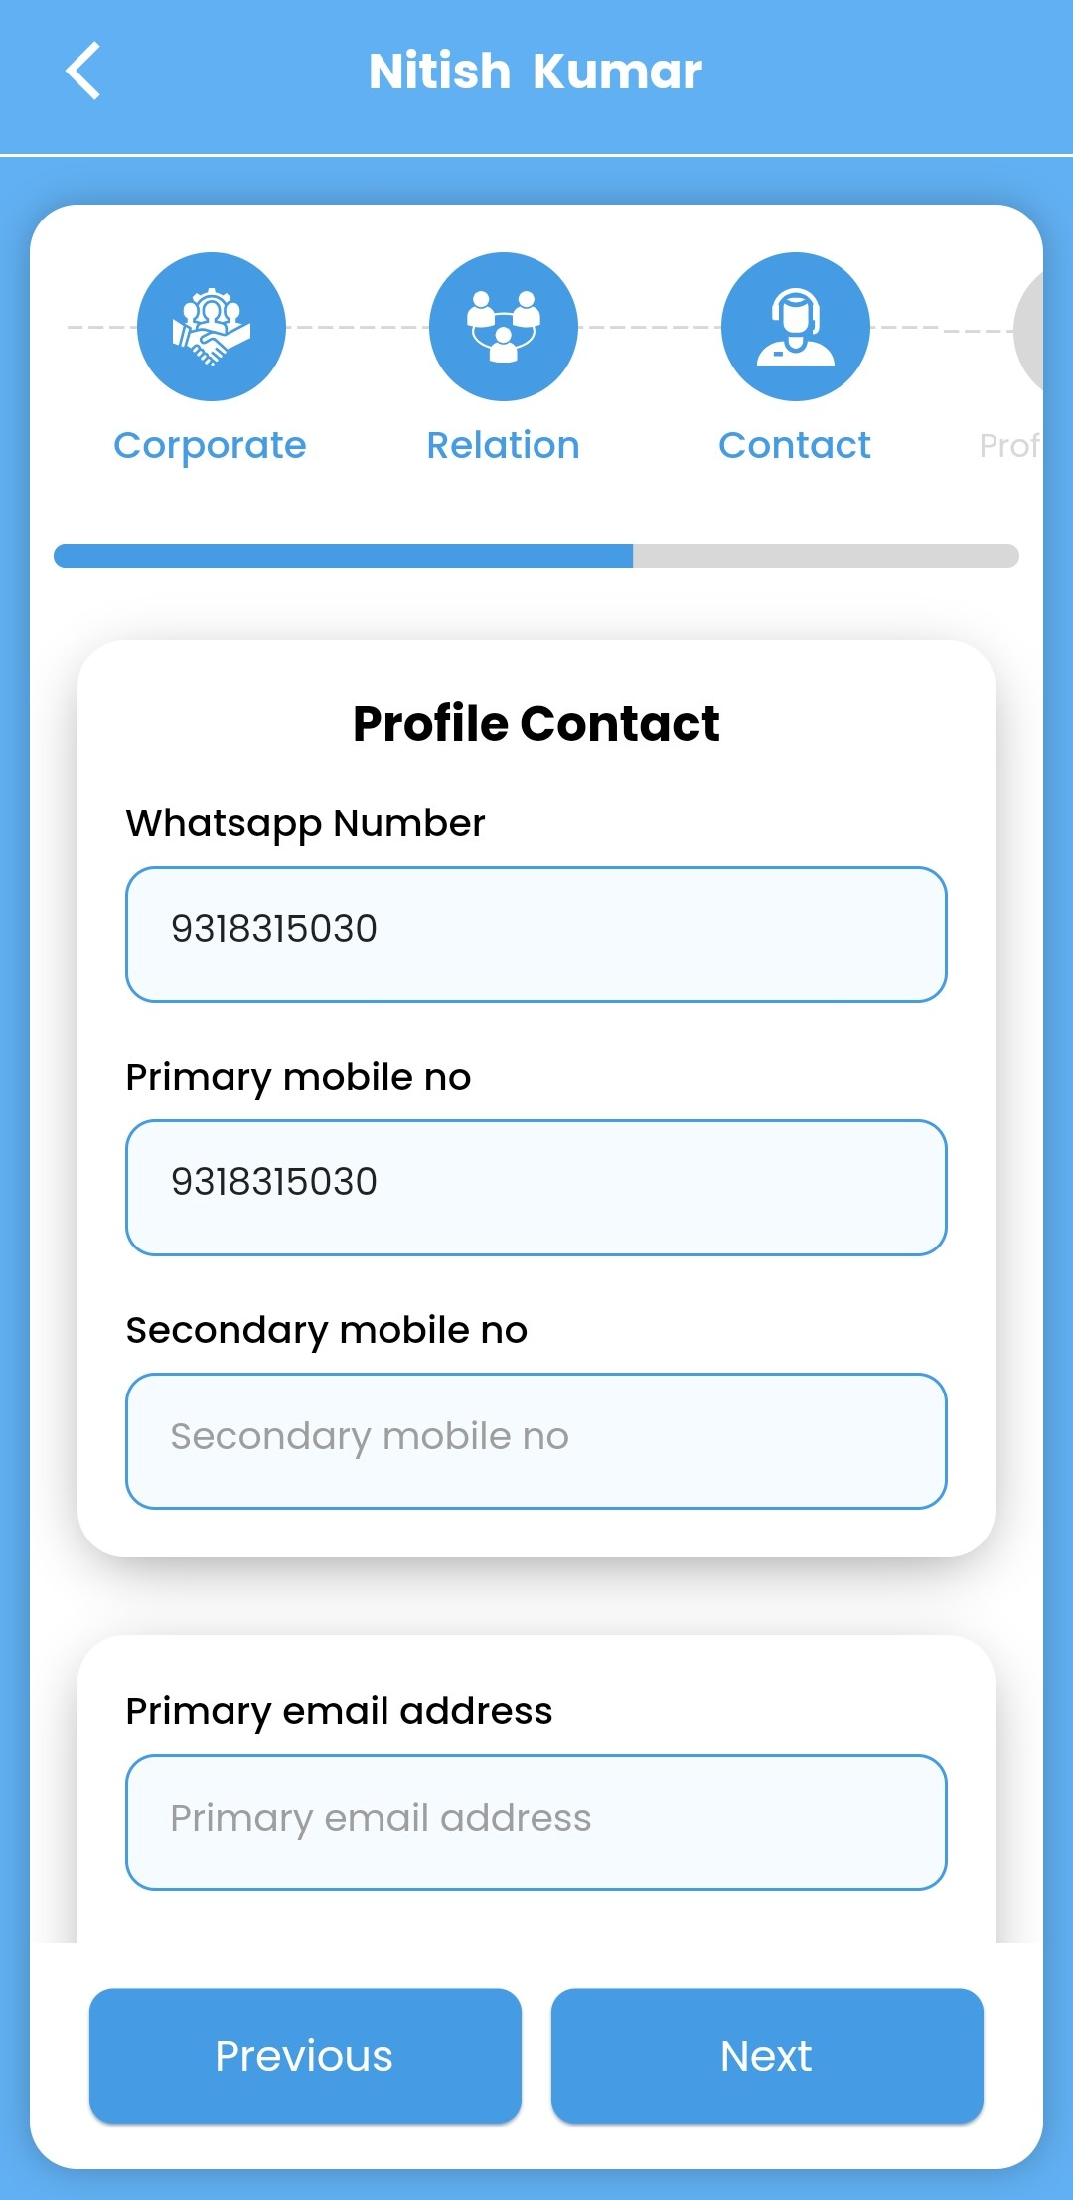
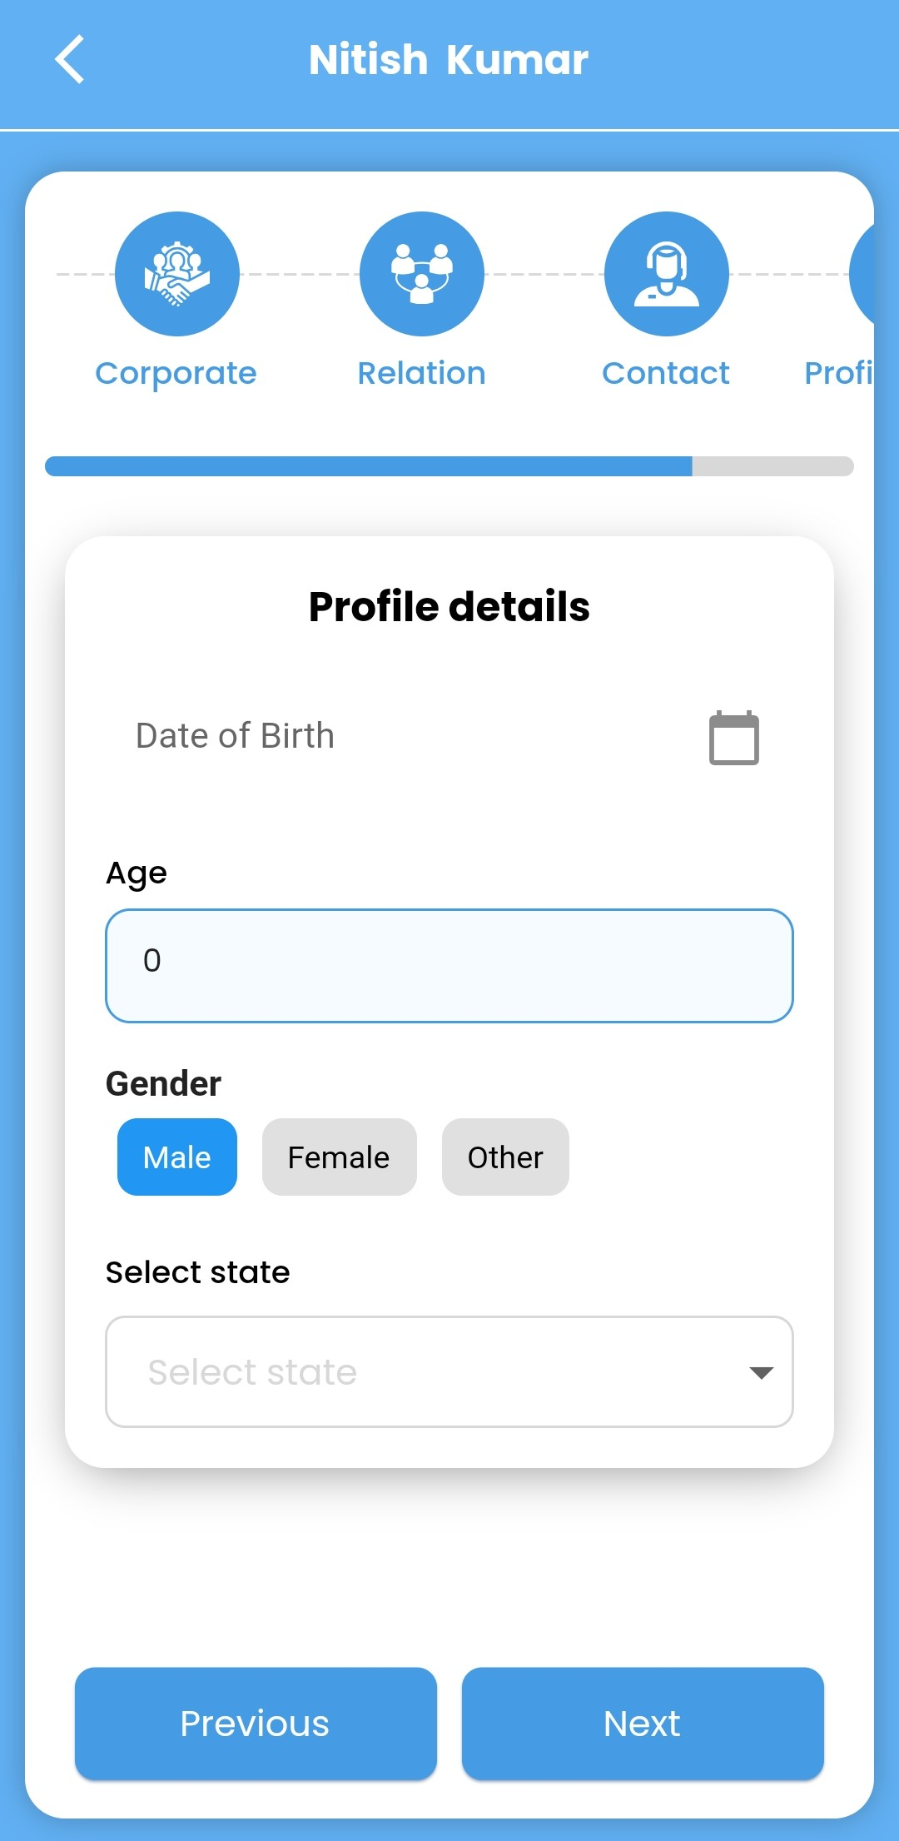
Customer Onboarding
Feel The Customer Data :
  Customer Details
  Relation Details
  Profile Contact
  Profile Details
  Gender
    Name
    Mid Name
    Last Name (Which is may required according to Corporate.)

Slide 7
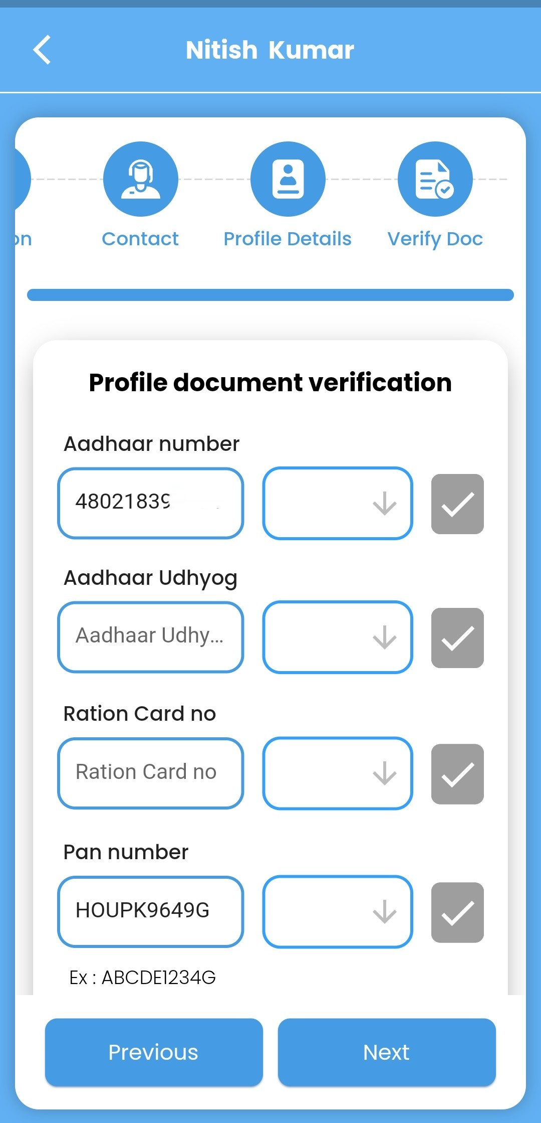
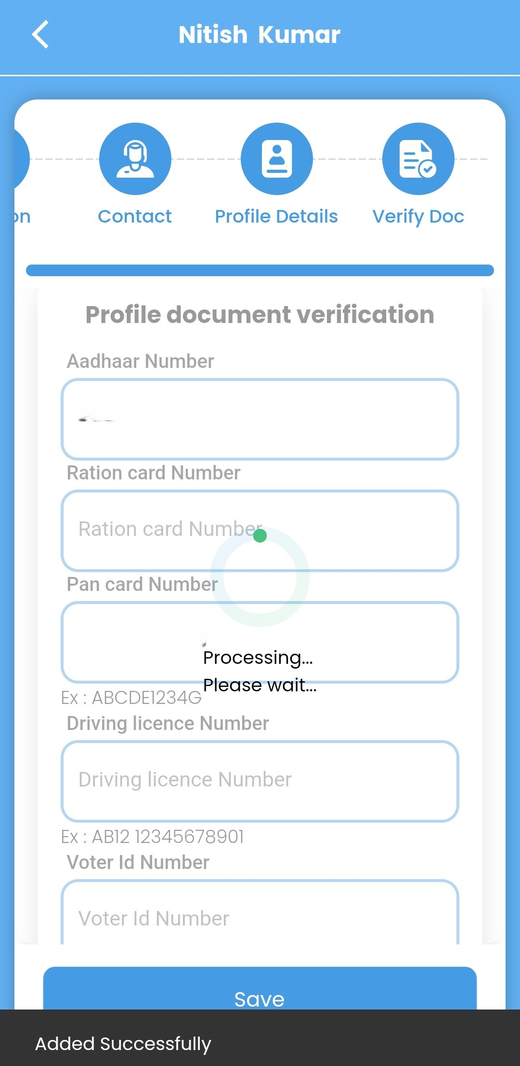
Profile Document Verification
Customer Profile Document Verification
  Aadhar Card & Pan Card
  Click on next and then Processing and wait.
    And view documents .

Slide 8
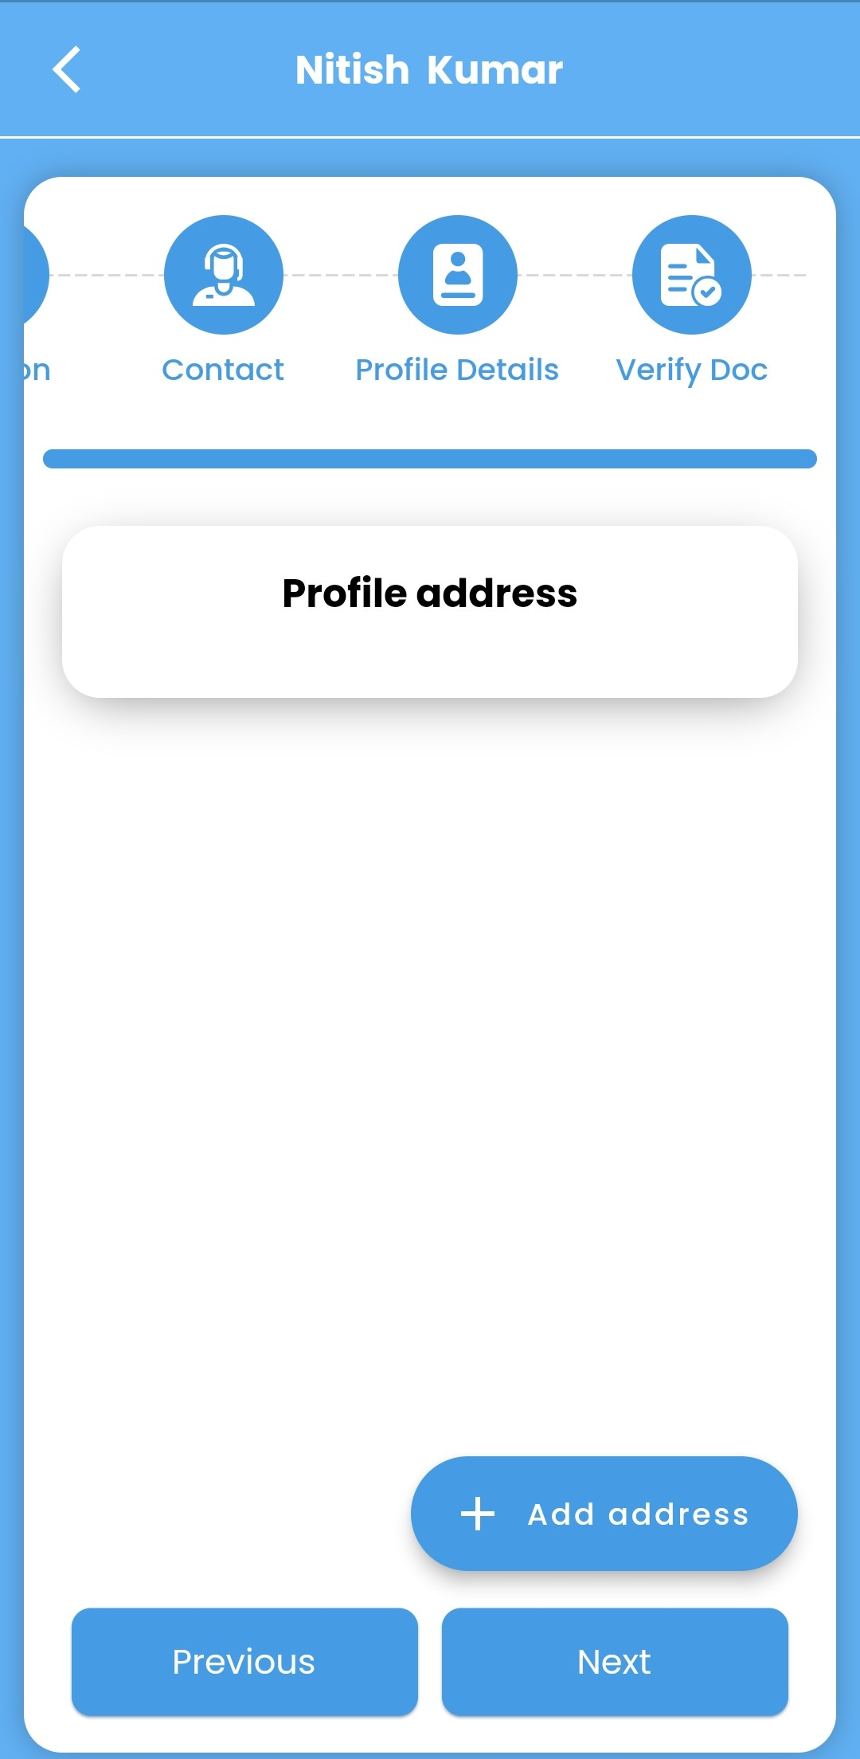
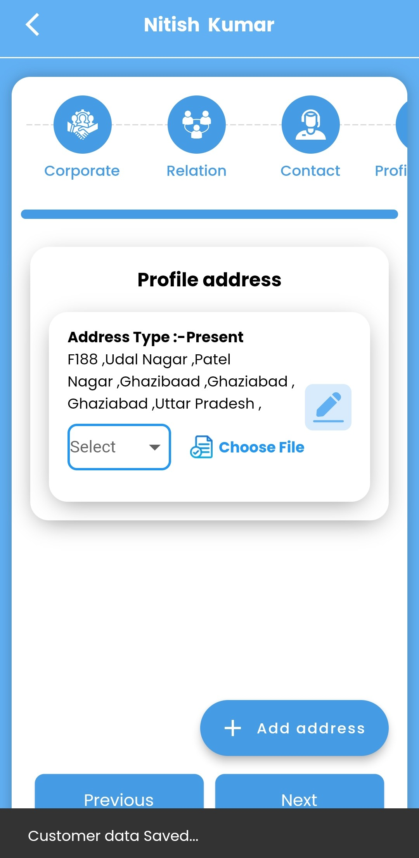
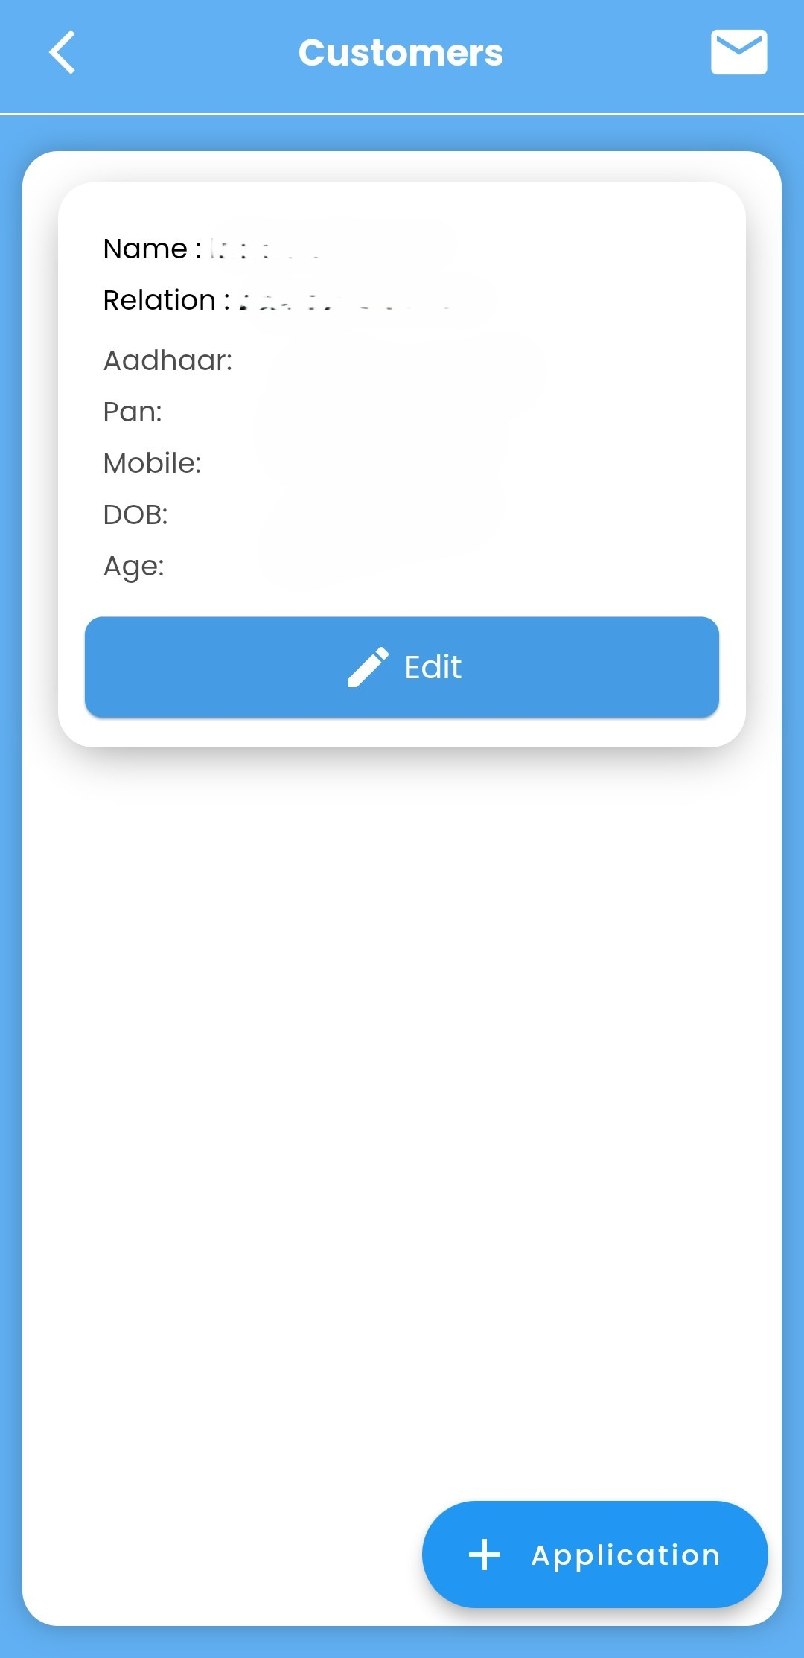
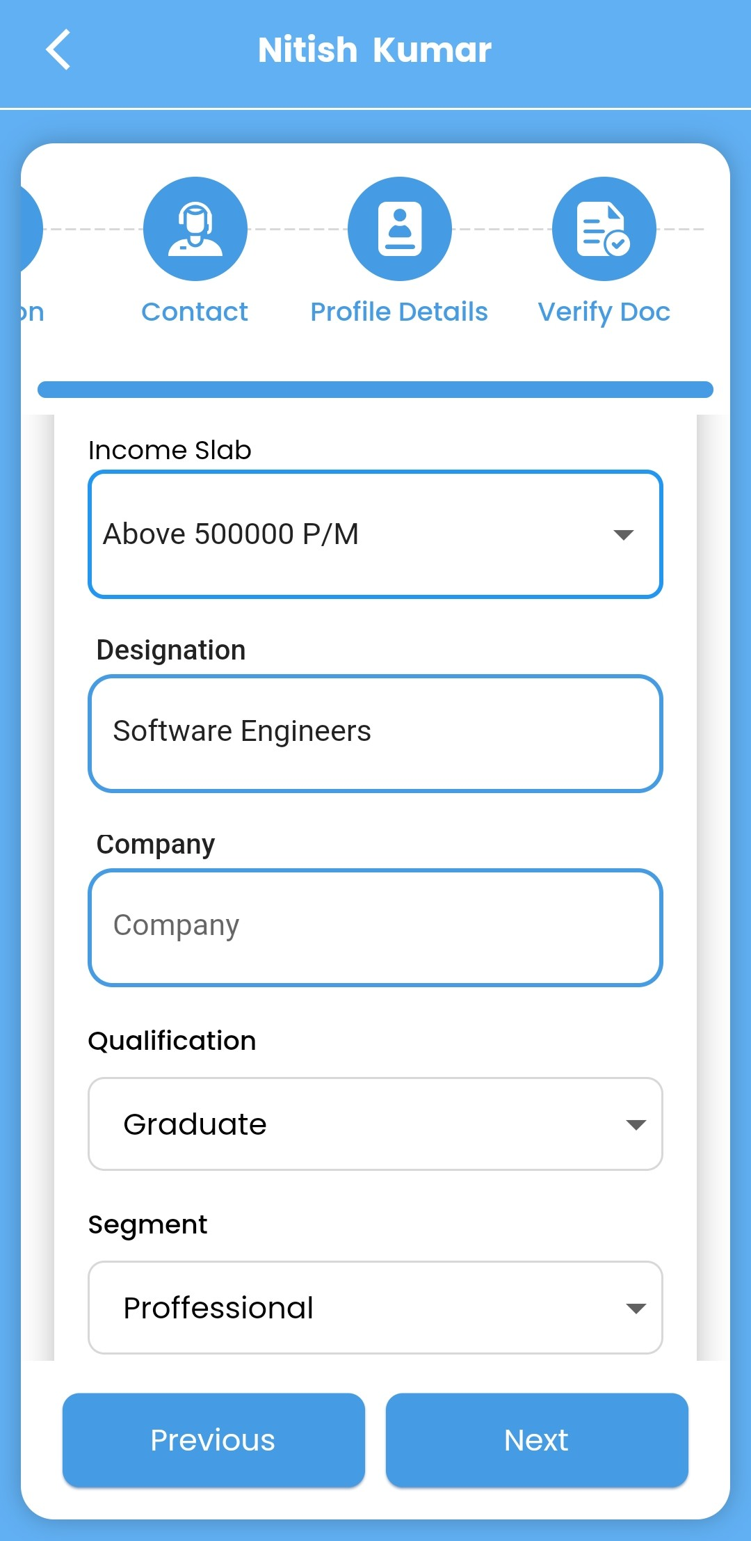
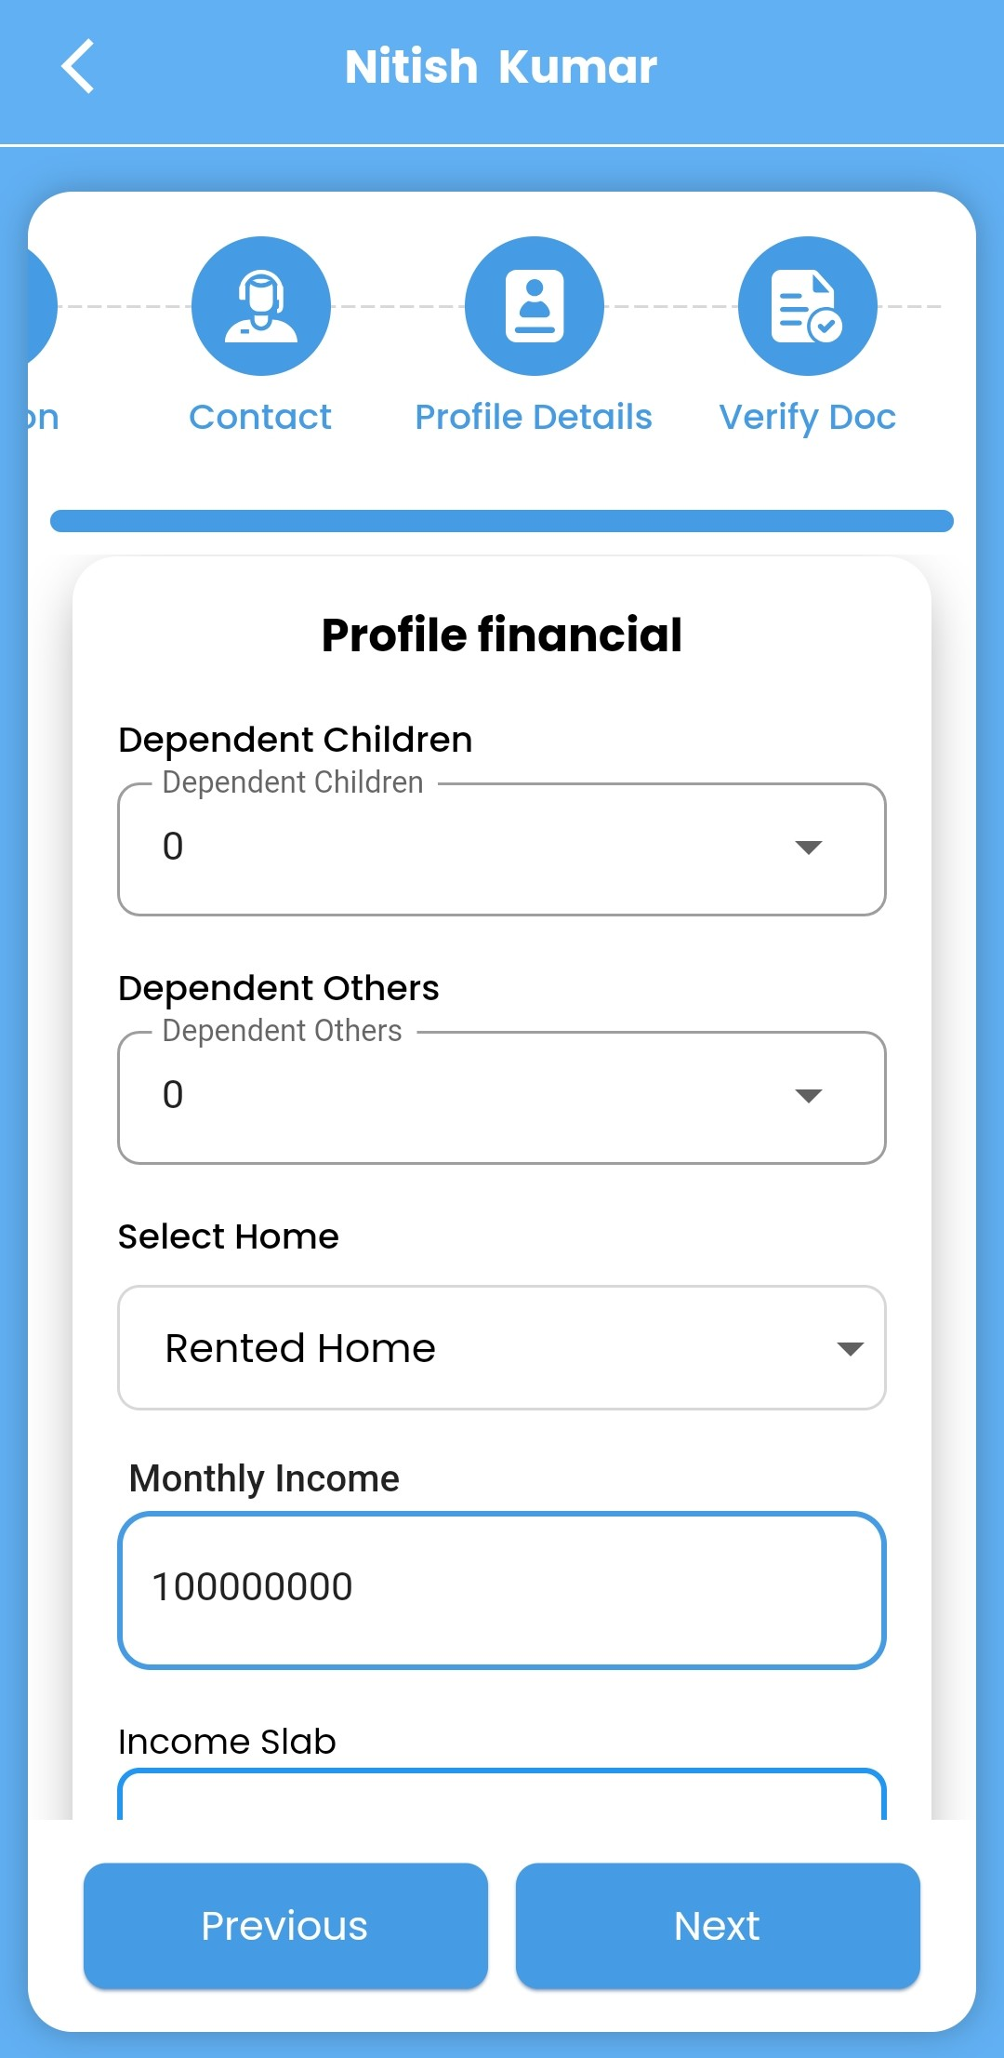
Profile Address & Profile Financial
Add Profile Address: -
Customer Profile Information
Name: Customer Name
Relation: Customer Relation Name
Aadhaar Number: Customer Aadhar Name
PAN Number: Customer Pan
Mobile Number:
Date of Birth:
Age: 27
Address Details
Address Type: Present
Full Address: Ghaziabad, Ghaziabad, Uttar Pradesh
Navigation Options
Corporate, Relation, Contact, Profile
Buttons for Actions
Add Bank, Add Address, Previous, Next
Status Messages
Customer data is being saved successfully.

Slide 9
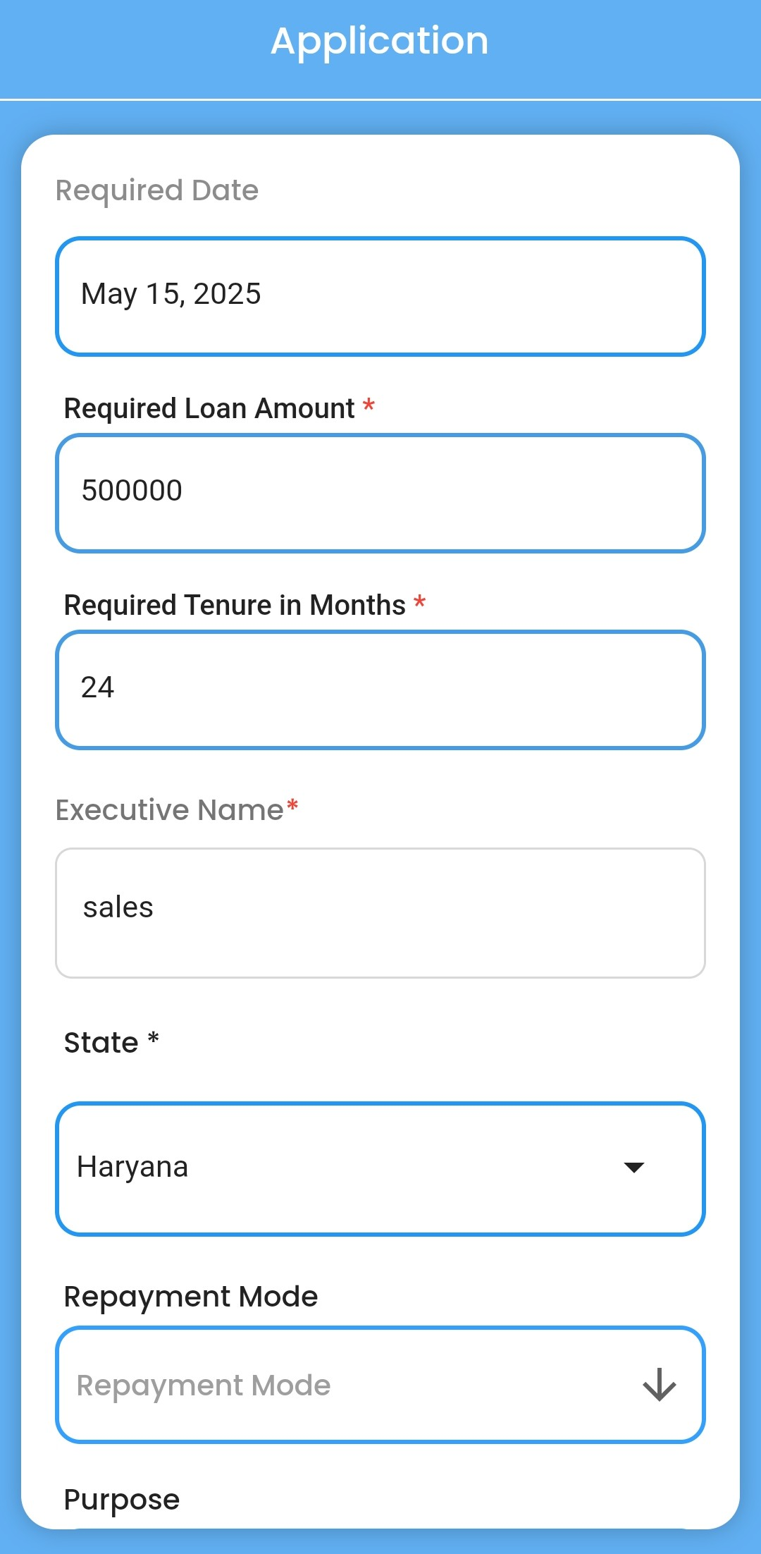
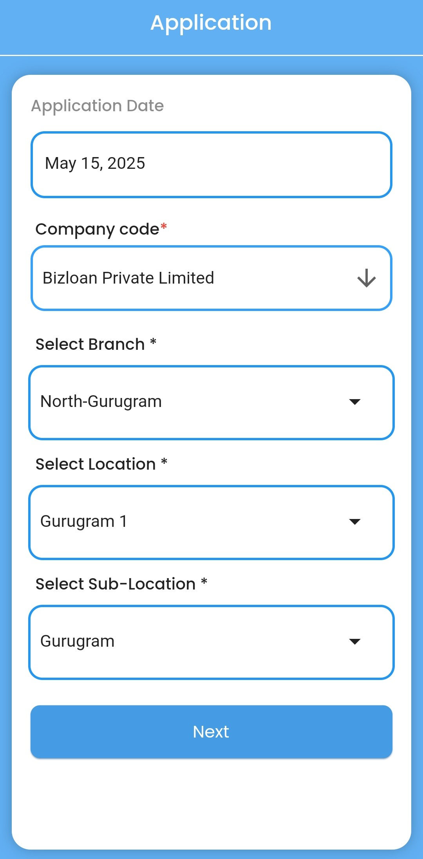
Feel Your Relation Contact
Loan Application Creation Process
After Customer onboarding we feel the application details .
Feel the application details like Required loan amount , Required tenure, State ,City repayment mode ex.
  Profile Financials.
  Property Information Entry.
  Loan Application Sections.

Slide 10
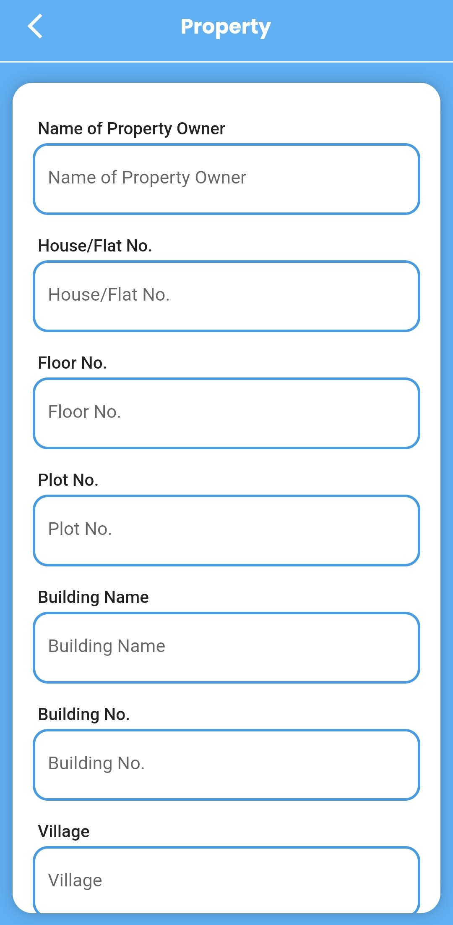
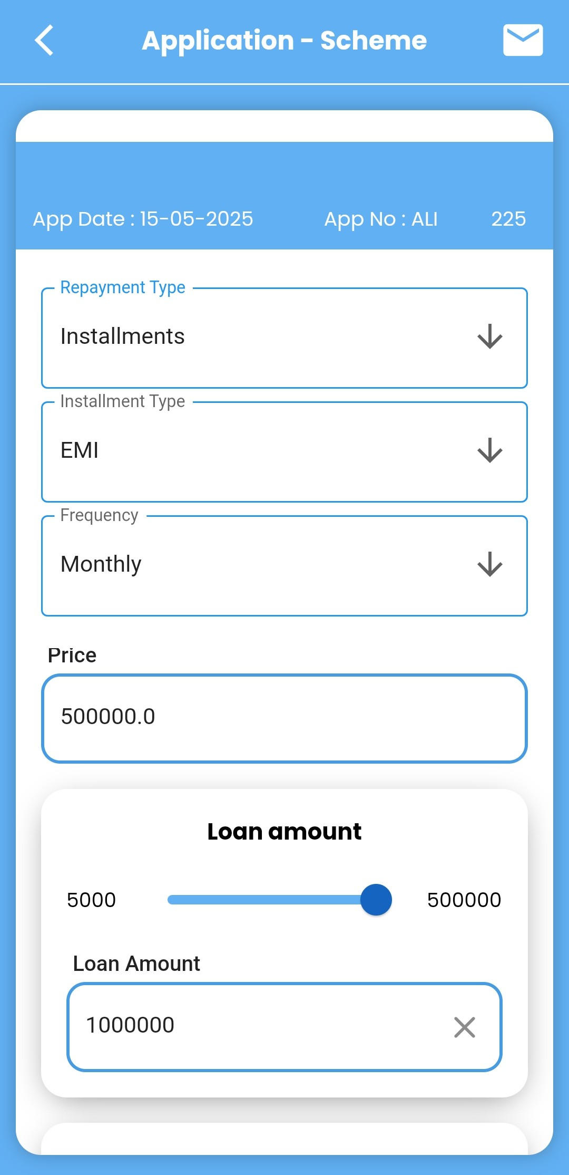
Fill Your Collateral Details
Name Of Property Owner
House / Flat No
Floor and Building name
Village / City
Fill Your Application -Scheme
Installments
EMI
Monthly
Price value

Slide 11
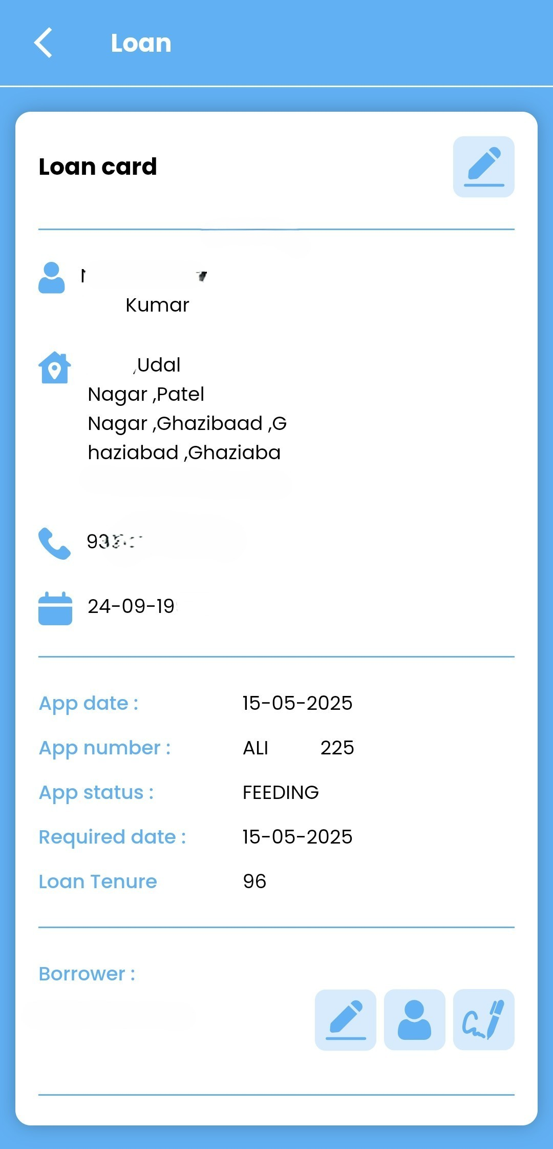
Loan Application Card
Customer data Fill:
Loan Application Card
Applicant Name: Customer Name
Nominee Name: - Customer Nominee Name
Contact Information:
  Phone Number: 93150
  Address: Udal Nagar, Patel Nagar, Ghaziabad, Uttar Pradesh
Application Details:
  Application Date: 15-05-2025
  Application Number:
  Application Status: Feeding
  Required Date: 15-05-2025
  Loan Amount : - 500000
  Loan Tenure: 96 months
Borrower: Customer Name

Slide 12
Key Features
User-Friendly Interfaces: Straightforward entry fields for loan applications and customer management.
Multiple Stages in Application Process: Step-by-step guidance for users from login to application submission.
Data Management: Input fields for customer and property details, enabling comprehensive financial management.
Conclusion
This application facilitates loan management by providing a structured interface for user login, customer data management, loan applications, and property verification, aimed at a seamless financial operation.

